Slide 1

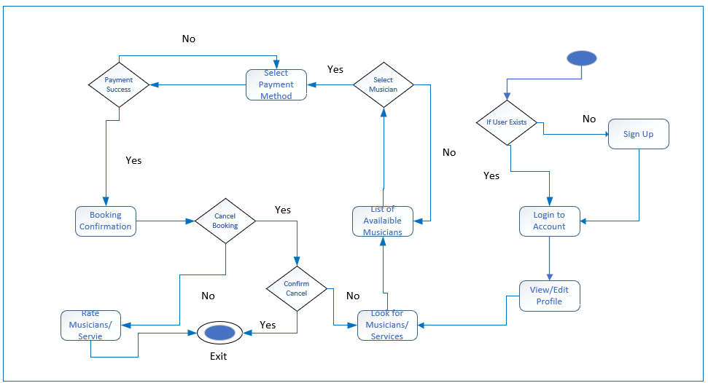
United Tune Activity Diagram for Customer

Slide 2
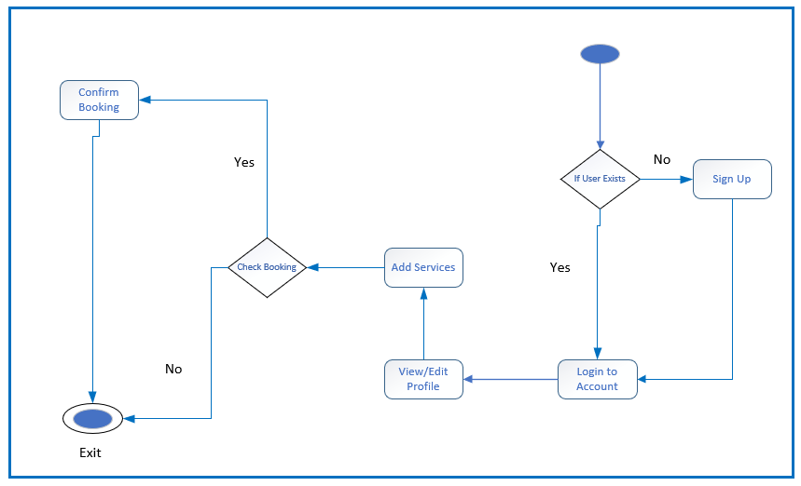
United Tune Activity Diagram for Musician

